Slide 1


Retrieval-Augmented Generation (RAG)
Enhancing AI with dynamic knowledge retrieval techniques
Arta Asadi
AI Learnino
Notes:
AI-generated content may be incorrect. ---

Slide 2
Introduction to RAG
Notes:
Definition of RAG, Details of RAG

Slide 3

Definition of RAG
RAG Overview
RAG combines information retrieval with large language models to generate context-aware and accurate responses.
Dynamic Data Retrieval
RAG dynamically retrieves relevant external data during inference, ensuring up-to-date and factual content.
Applications and Benefits
RAG is valuable in precision-critical domains like legal, medical, and technical fields for reliable information generation.
Notes:
Retrieval-Augmented Generation (RAG) is an advanced approach that combines the capabilities of information retrieval systems with large language models (LLMs) to generate accurate, context-aware responses. Unlike traditional generative models that rely solely on pre-trained knowledge, RAG dynamically retrieves relevant documents or data from external sources during inference. This integration ensures that the generated content is grounded in factual and up-to-date information, reducing hallucinations and improving reliability. The process involves embedding queries, searching through vector databases or structured repositories, and feeding retrieved context into the generative model. RAG is particularly useful in domains requiring precision, such as legal, medical, and technical fields, where incorrect or outdated information can have significant consequences. By leveraging retrieval mechanisms, RAG bridges the gap between static model knowledge and dynamic real-world data, making it a cornerstone for next-generation AI applications.

Slide 4
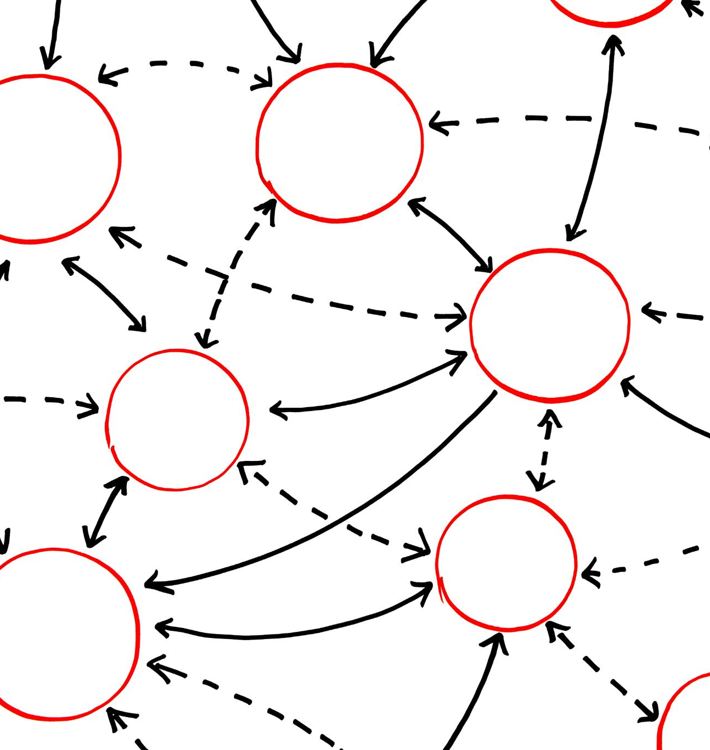
Details of RAG
Multi-step Pipeline
RAG processes user queries by extracting semantic meanings and retrieving relevant documents from vector stores.
Integration with LLM
Retrieved content combined with original prompt is passed to a large language model to generate context-informed responses.
Advanced Features and Applications
RAG supports function calling, tool integration, and is suited for tasks like question answering and summarization.
Notes:
RAG operates through a multi-step pipeline that integrates search and generation. First, a query or user prompt is processed to extract semantic meaning, often using embeddings. These embeddings are then matched against a vector store or database to retrieve the most relevant documents. The retrieved content is appended to the original prompt and passed to an LLM, which generates a response informed by both its internal knowledge and the external context. This approach improves factual accuracy, supports domain-specific customization, and enables real-time updates. Key components include retrieval algorithms (such as BM25 or dense embeddings), vector databases like Qdrant, and orchestration frameworks such as LangChain. RAG systems can also incorporate advanced features like function calling and tool integration, allowing dynamic execution of external processes during generation. These capabilities make RAG highly adaptable for complex workflows, including question answering, summarization, and decision support.

Slide 5
Types and Techniques
Notes:
Types of RAG, Text Retrieval Techniques

Slide 6
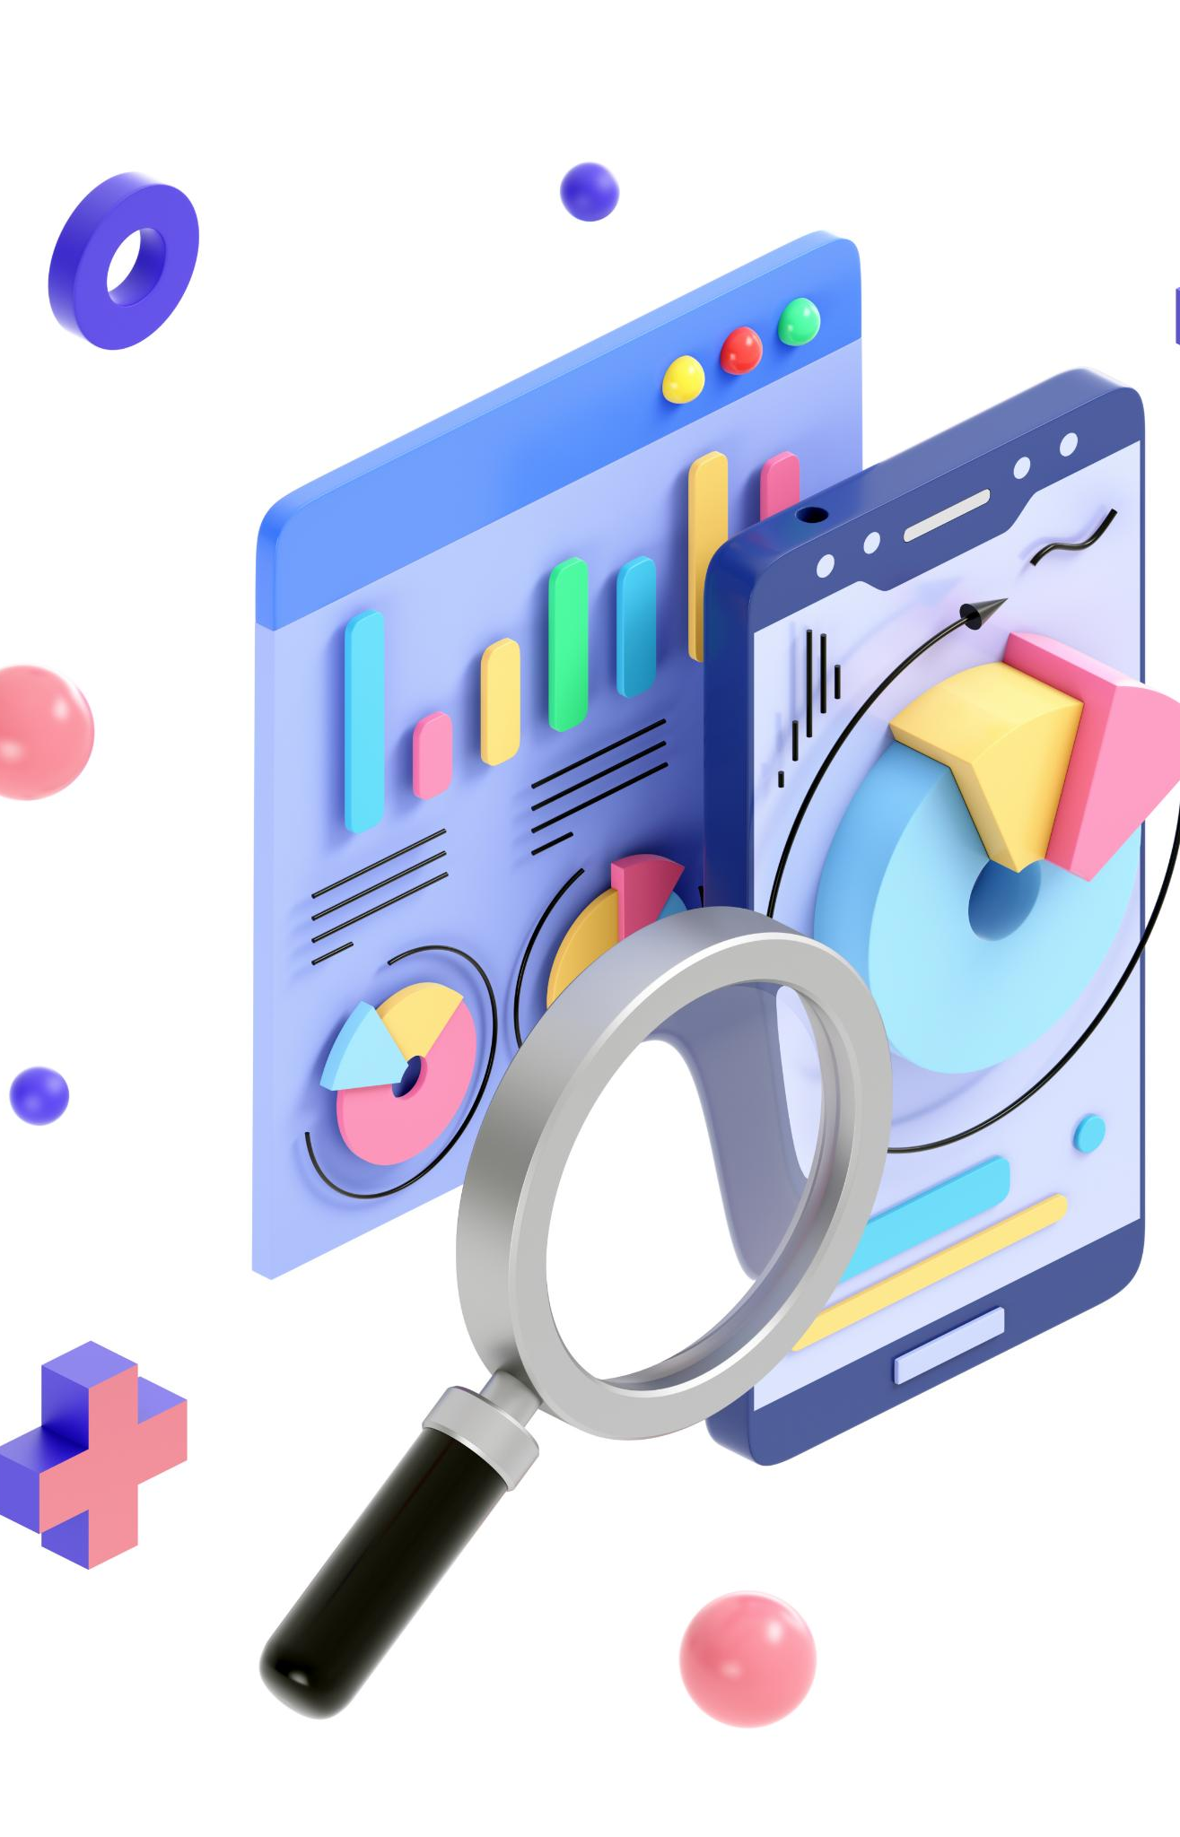
Types of RAG
Document-Based RAG
Fetches relevant text passages from large document corpora, ideal for knowledge-intensive tasks and unstructured text.
Graph-Based RAG
Uses graph databases and relationship mapping to retrieve interconnected information, aiding contextual understanding.
Hybrid RAG
Combines keyword-based and semantic search methods to maximize retrieval accuracy and flexibility.
Notes:
RAG implementations vary based on the retrieval strategy and data structure. Document-based RAG focuses on fetching relevant text passages from large corpora, making it ideal for knowledge-intensive tasks. Graph RAG, on the other hand, leverages graph databases and relationship mapping to retrieve interconnected information, enhancing contextual understanding. Hybrid RAG combines multiple retrieval methods, such as keyword-based and semantic search, to maximize accuracy. Each type addresses specific challenges: document-based RAG excels in handling unstructured text, while graph-based approaches are suited for domains where relationships between entities are critical, such as biomedical research or supply chain analysis. Hybrid models offer flexibility by integrating strengths from both approaches, ensuring comprehensive coverage of user queries.

Slide 7
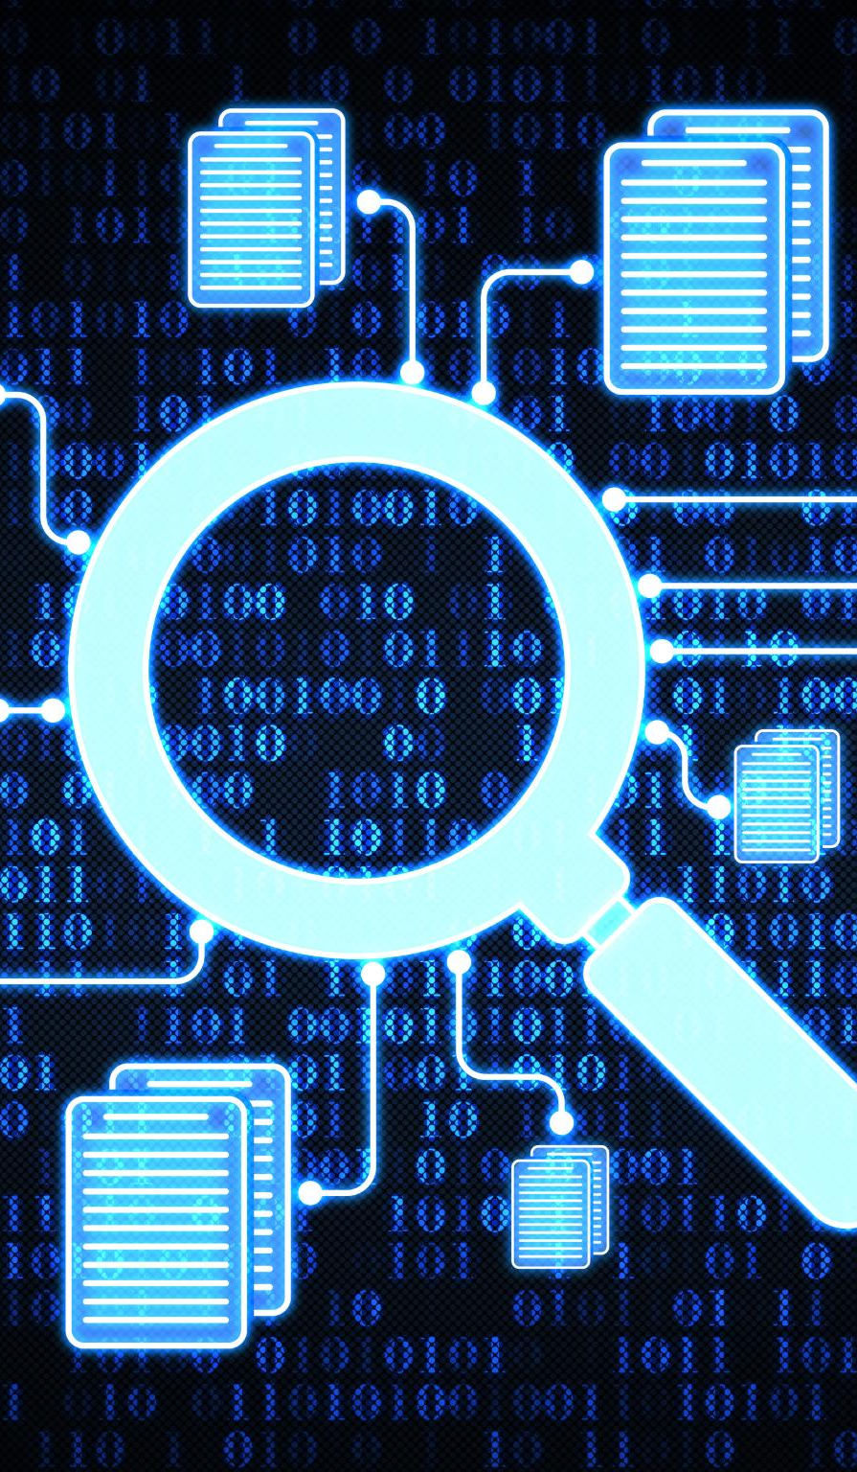
Text Retrieval Techniques
Keyword-Based Retrieval
BM25 ranks documents using term frequency and relevance, serving as a strong baseline for text retrieval.
Dense Retrieval with Embeddings
Neural networks generate embeddings to capture semantic similarity between queries and documents.
Vector Databases and ANN
Embeddings stored in vector databases enable efficient similarity search with approximate nearest neighbor algorithms.
Hybrid Retrieval Approaches
Combining keyword and semantic methods improves retrieval accuracy and system performance.
Notes:
Text retrieval in RAG systems employs both traditional and modern techniques. Keyword-based methods like BM25 rank documents based on term frequency and relevance, providing a strong baseline for retrieval. However, these methods often struggle with semantic understanding. To address this, dense retrieval techniques use embeddings generated by neural networks to capture semantic similarity between queries and documents. These embeddings are stored in vector databases, enabling efficient similarity searches. Combining keyword and semantic approaches can further enhance retrieval performance. Additionally, advanced indexing strategies and approximate nearest neighbor (ANN) algorithms optimize search speed and scalability, making text retrieval a critical component of high-performing RAG systems.

Slide 8
Why RAG and Core Components
Notes:
Why RAG?, Databases and Vector Stores

Slide 9
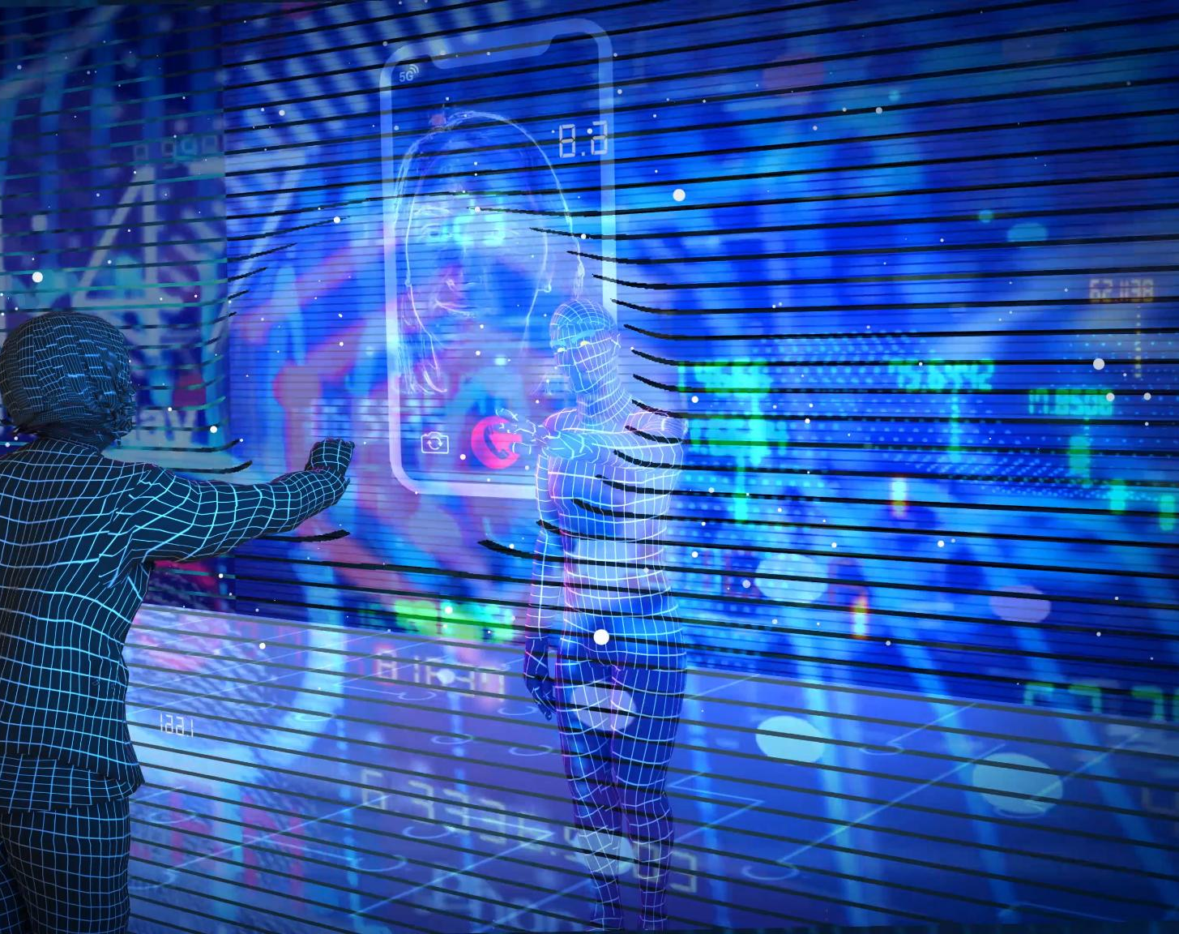
Why RAG?
Enhanced Model Reliability
RAG improves large language models by integrating real-time data retrieval to reduce outdated or incorrect responses.
Improved Factual Accuracy
Incorporating current data lowers hallucinations and increases the factual correctness of generated outputs.
Secure Proprietary Integration
RAG allows safe integration of internal knowledge bases with generative AI, supporting domain customization and compliance.
Versatile Application Benefits
RAG is essential for customer support, research, and enterprise solutions by providing traceable and relevant content.
Notes:
The primary motivation for using RAG is to enhance the performance and reliability of large language models. Traditional LLMs are limited by their static training data, which can lead to outdated or incorrect responses. RAG mitigates these issues by incorporating real-time retrieval, ensuring that generated outputs are grounded in current and relevant information. This reduces hallucinations, improves factual accuracy, and enables domain-specific customization. RAG also supports compliance with regulatory requirements by providing traceable sources for generated content. Furthermore, it allows organizations to leverage proprietary data securely, integrating internal knowledge bases with generative AI capabilities. These benefits make RAG indispensable for applications in customer support, research, and enterprise solutions.

Slide 10
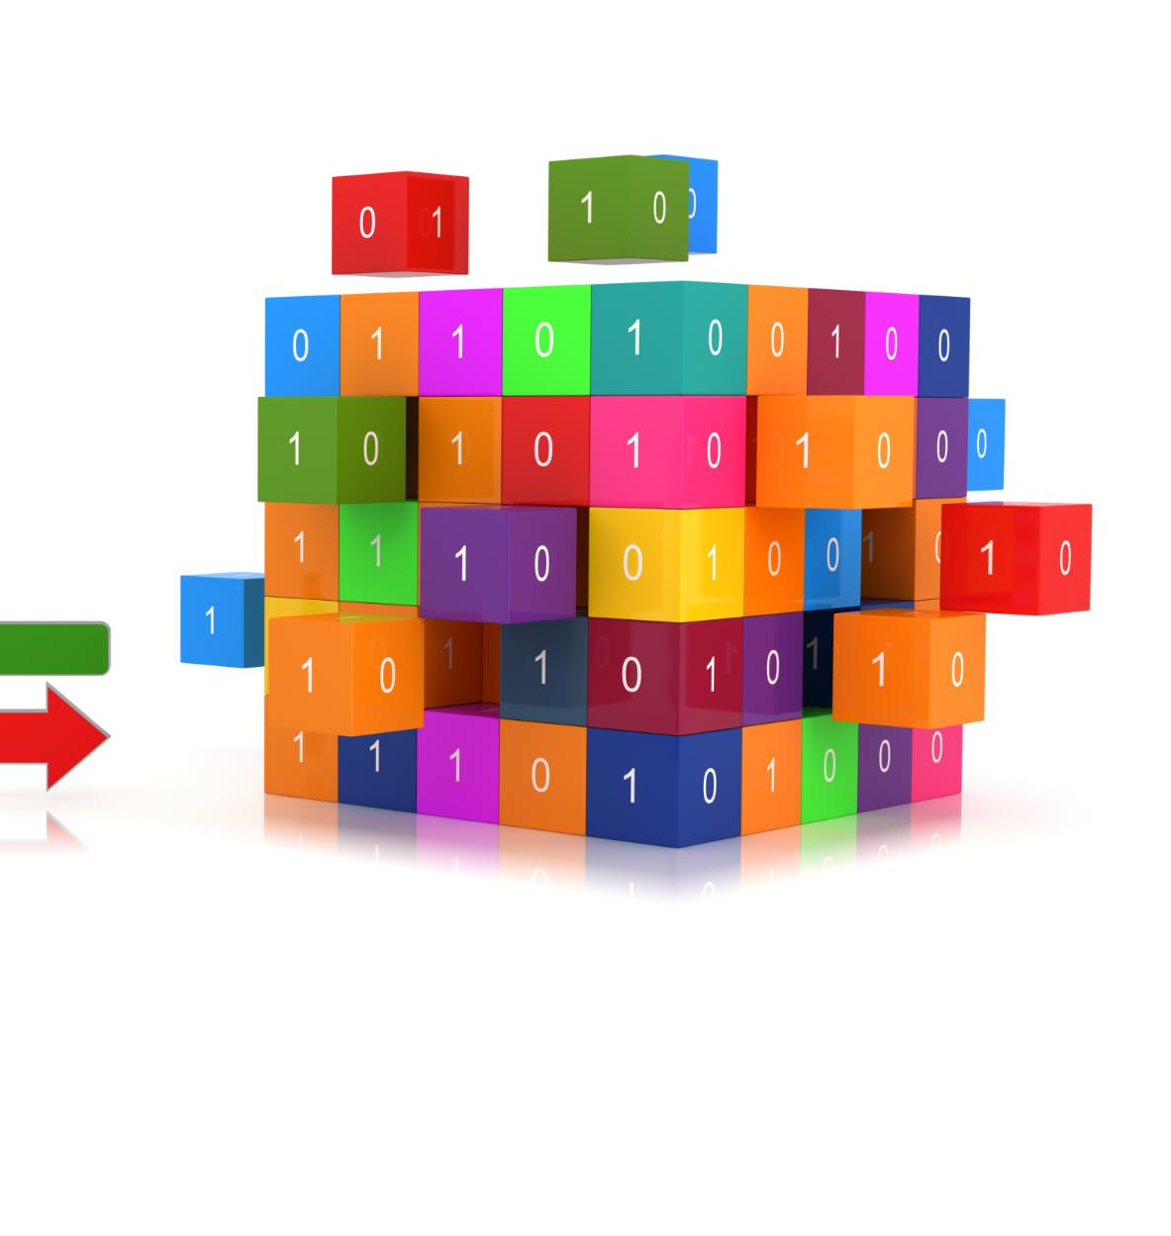
Databases and Vector Stores
Relational Databases
Structured databases like Postgres manage relational data with strong querying and transaction capabilities.
NoSQL Flexibility
NoSQL databases handle semi-structured or unstructured data, supporting dynamic content and flexible schemas.
Vector Stores for Semantic Search
Vector stores like Qdrant store high-dimensional embeddings optimized for similarity and hybrid queries in semantic search.
Notes:
Databases and vector stores form the backbone of RAG systems. Structured databases like Postgres are used for relational data, offering robust querying and transaction support. NoSQL databases provide flexibility for handling semi-structured or unstructured data, making them suitable for dynamic content. Vector stores, such as Qdrant, specialize in storing and retrieving high-dimensional embeddings for semantic search. Qdrant is optimized for similarity search and supports features like filtering and hybrid queries. These storage solutions enable efficient retrieval of relevant context, ensuring that the generative model receives accurate and comprehensive information. The choice of database depends on the nature of the data and the retrieval requirements of the application.

Slide 11
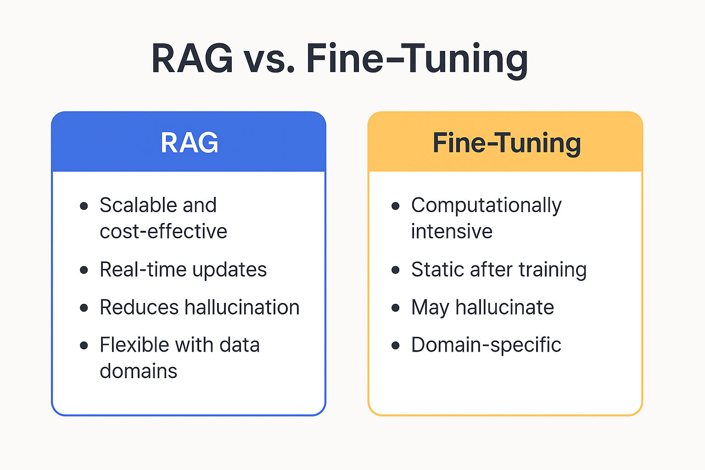
Why Choose RAG Over Fine-Tuning?
Scalable & Cost-Efficient
No retraining needed for large datasets.
Real-Time Updates
Instantly integrates new data without model updates.
Reduces Hallucination
Grounds responses in retrieved factual content.
Domain Flexibility
Easily adapts to multiple or proprietary domains.
Traceability & Compliance
Provides source references for generated outputs.
Notes:
The primary motivation for using RAG is to enhance the performance and reliability of large language models. Traditional LLMs are limited by their static training data, which can lead to outdated or incorrect responses. RAG mitigates these issues by incorporating real-time retrieval, ensuring that generated outputs are grounded in current and relevant information. This reduces hallucinations, improves factual accuracy, and enables domain-specific customization. RAG also supports compliance with regulatory requirements by providing traceable sources for generated content. Furthermore, it allows organizations to leverage proprietary data securely, integrating internal knowledge bases with generative AI capabilities. These benefits make RAG indispensable for applications in customer support, research, and enterprise solutions.

Slide 12
Advanced Features and Libraries
Notes:
Function Calling and Tool Integration, Libraries for RAG

Slide 13
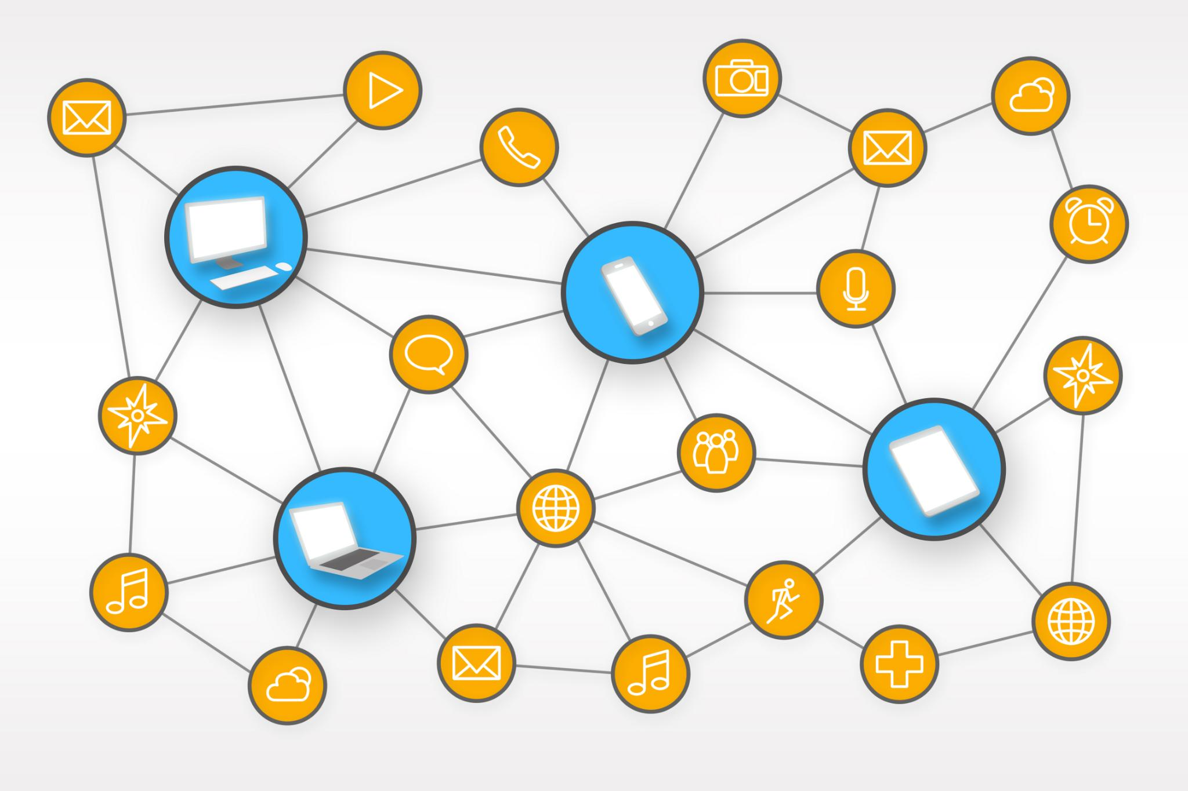
Function Calling and Tool Integration
Function Calling Capabilities
Function calling enables dynamic execution of predefined operations like calculations and API queries within RAG systems.
Tool Integration Benefits
Tool integration allows RAG systems to interact with external services, enhancing workflow versatility and automation.
Enhanced Task Support
These features support complex tasks including data analysis, report generation, and automated decision-making.
Orchestrated Tool Pipelines
Orchestrating multiple tools in a pipeline enables tailored comprehensive solutions for specific business needs.
Notes:
Modern RAG systems extend beyond simple retrieval and generation by incorporating function calling and tool integration. Function calling allows the model to execute predefined operations dynamically, such as performing calculations or querying APIs. Tool integration enables interaction with external systems, creating workflows that combine generative AI with specialized services. These features enhance the versatility of RAG, supporting complex tasks like data analysis, report generation, and automated decision-making. By orchestrating multiple tools within a single pipeline, RAG systems can deliver comprehensive solutions tailored to specific business needs.

Slide 14
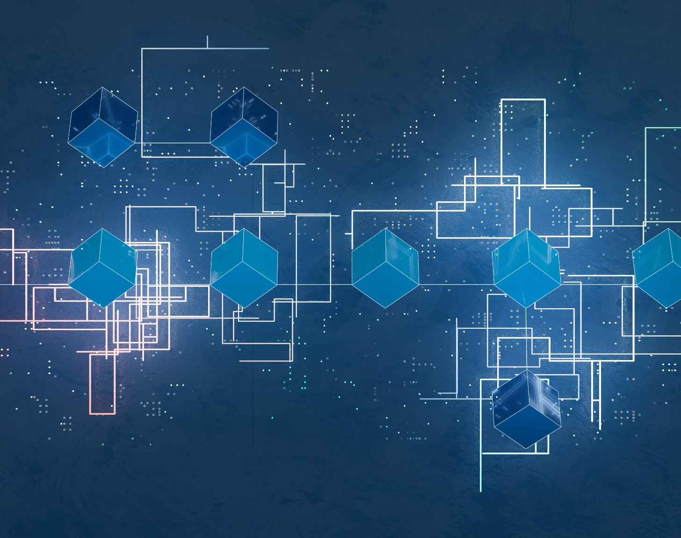
Libraries for RAG
Modular Frameworks
LangChain offers modular components for building retrieval-augmented pipelines integrated with language models and databases.
Graph-Based Orchestration
LangGraph enables complex workflows using graph structures to manage relational data within RAG systems.
Advanced Retrieval Optimization
Agno specializes in advanced retrieval strategies and optimization techniques for efficient data access.
Collaborative AI Agents
CrewAI supports agent-based architectures enabling collaborative AI systems for enhanced performance.
Notes:
Several libraries facilitate the development of RAG systems. LangChain provides a framework for building retrieval-augmented pipelines, offering modular components for integration with LLMs and databases. LangGraph introduces graph-based orchestration, enabling complex workflows that leverage relational data. Agno focuses on advanced retrieval strategies and optimization, while CrewAI supports agent-based architectures for collaborative AI systems. These libraries simplify the implementation of RAG, providing developers with tools to create scalable, efficient, and feature-rich applications. Their growing ecosystems ensure continuous innovation and support for emerging use cases.

Slide 15
LLM Backend and Graph RAG
Notes:
LLM Usage as Backend, Graph RAG Definition and Architecture

Slide 16
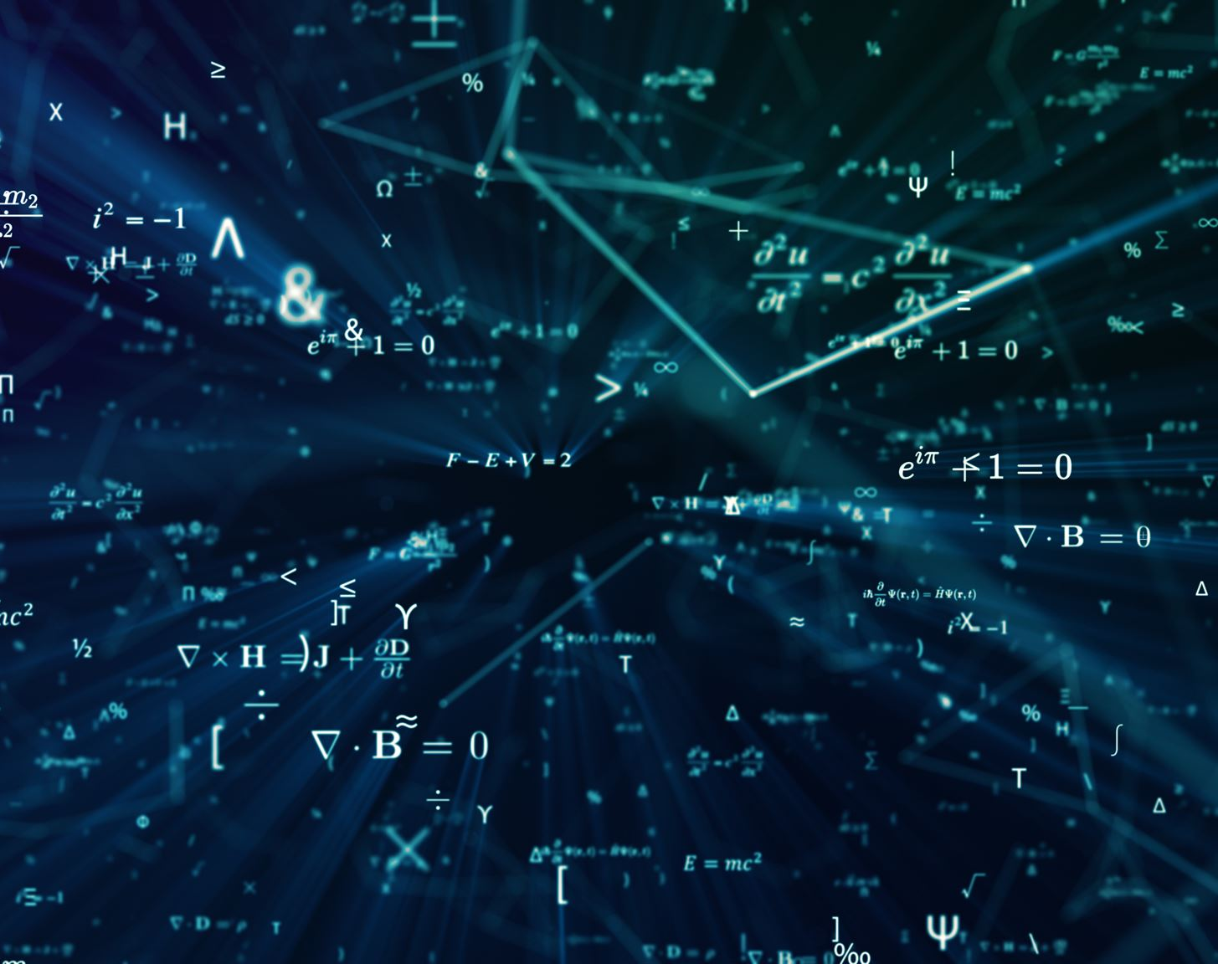
LLM Usage as Backend
Generative Role in RAG Systems
LLMs transform retrieved information into coherent and informative responses, acting as the generative engine in RAG systems.
Processing User Queries and Documents
LLMs synthesize user queries and appended documents using advanced language understanding for accurate outputs.
Dynamic and Context-Aware Interaction
Combining retrieval with generation enables LLMs to provide dynamic responses beyond static knowledge bases.
LLM Selection Factors
Choosing an LLM depends on performance, scalability, and domain-specific needs to optimize backend effectiveness.
Notes:
In RAG systems, large language models serve as the generative engine, transforming retrieved context into coherent and informative outputs. The LLM processes both the user query and the appended retrieved documents, leveraging its language understanding capabilities to synthesize accurate responses. This backend role is critical for maintaining fluency and relevance in generated content. By combining retrieval with generation, LLMs overcome limitations of static knowledge, enabling dynamic and context-aware interactions. The choice of LLM, such as GPT or LLaMA, depends on factors like performance, scalability, and domain-specific requirements.

Slide 17
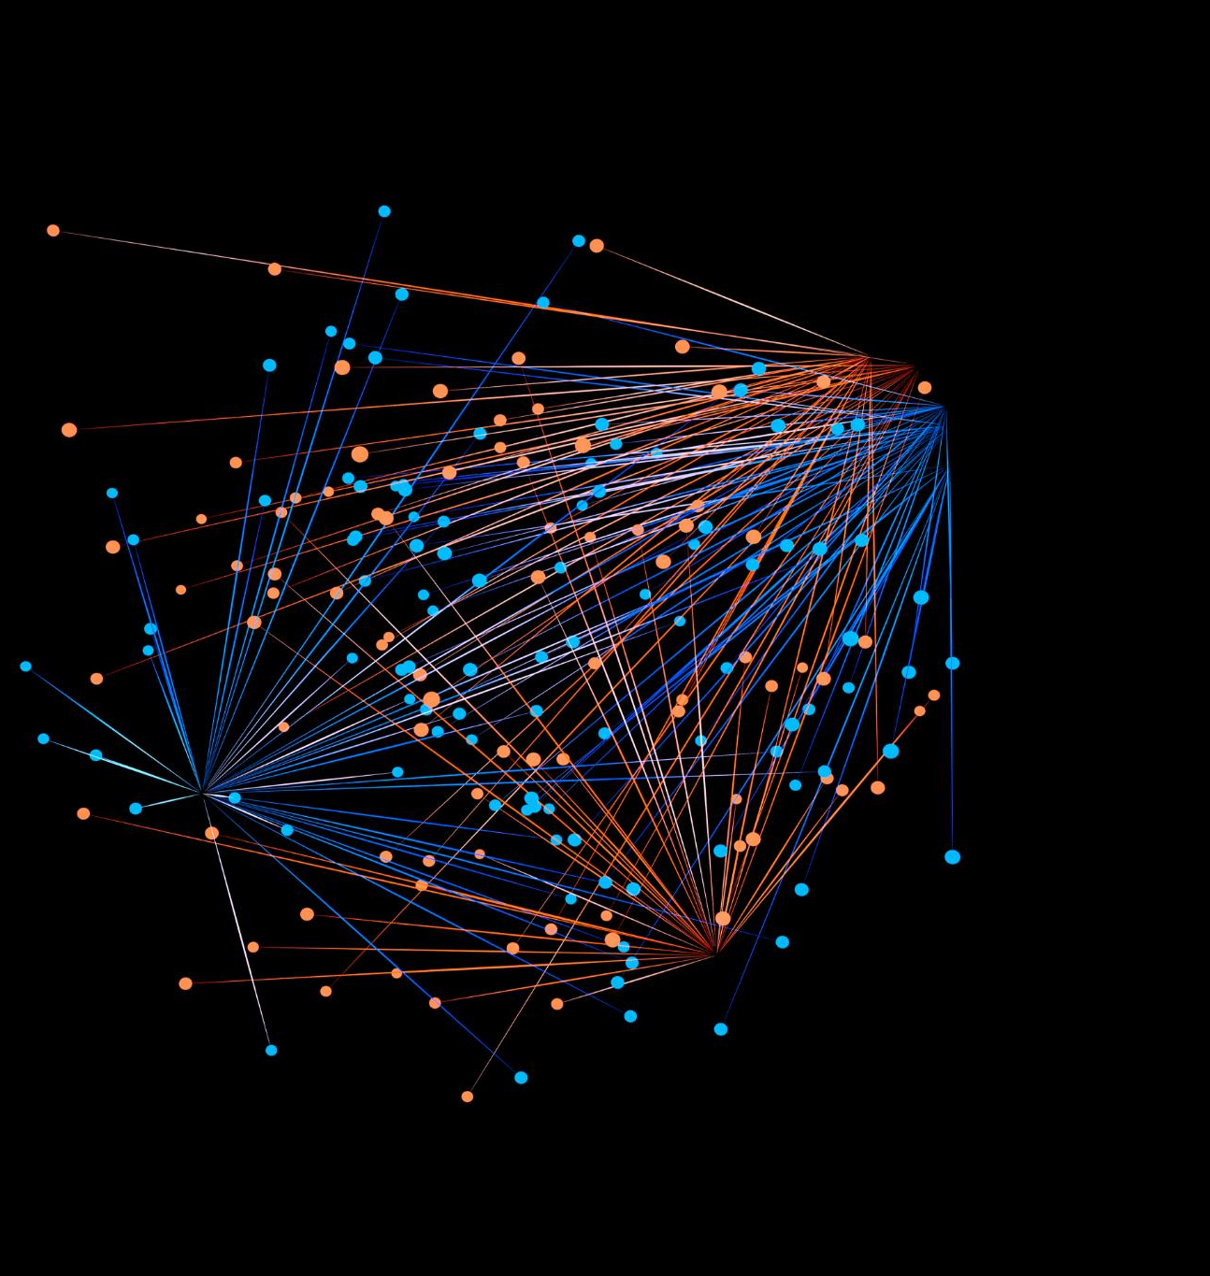
Graph RAG Definition and Architecture
Graph-Based Retrieval
Graph RAG uses graph databases to capture complex relationships between entities for accurate context retrieval.
Graph Traversal & Embeddings
Graph traversal algorithms and semantic embeddings identify relevant nodes and edges for rich contextual information.
Enhanced Contextualization
Integrating graph-based retrieval enables deeper understanding and improved reasoning in generative models.
Notes:
Graph RAG is a specialized form of retrieval-augmented generation that utilizes graph databases to represent and query relationships between entities. Unlike document-based approaches, Graph RAG focuses on interconnected data, enabling retrieval of context that reflects complex relationships. This architecture is particularly valuable in domains like biomedical research, where understanding entity interactions is crucial. Graph RAG systems employ graph traversal algorithms and semantic embeddings to identify relevant nodes and edges, providing rich contextual information for the generative model. By integrating graph-based retrieval, RAG achieves deeper contextualization and improved reasoning capabilities.

Slide 18
References
Notes:
Key References

Slide 19
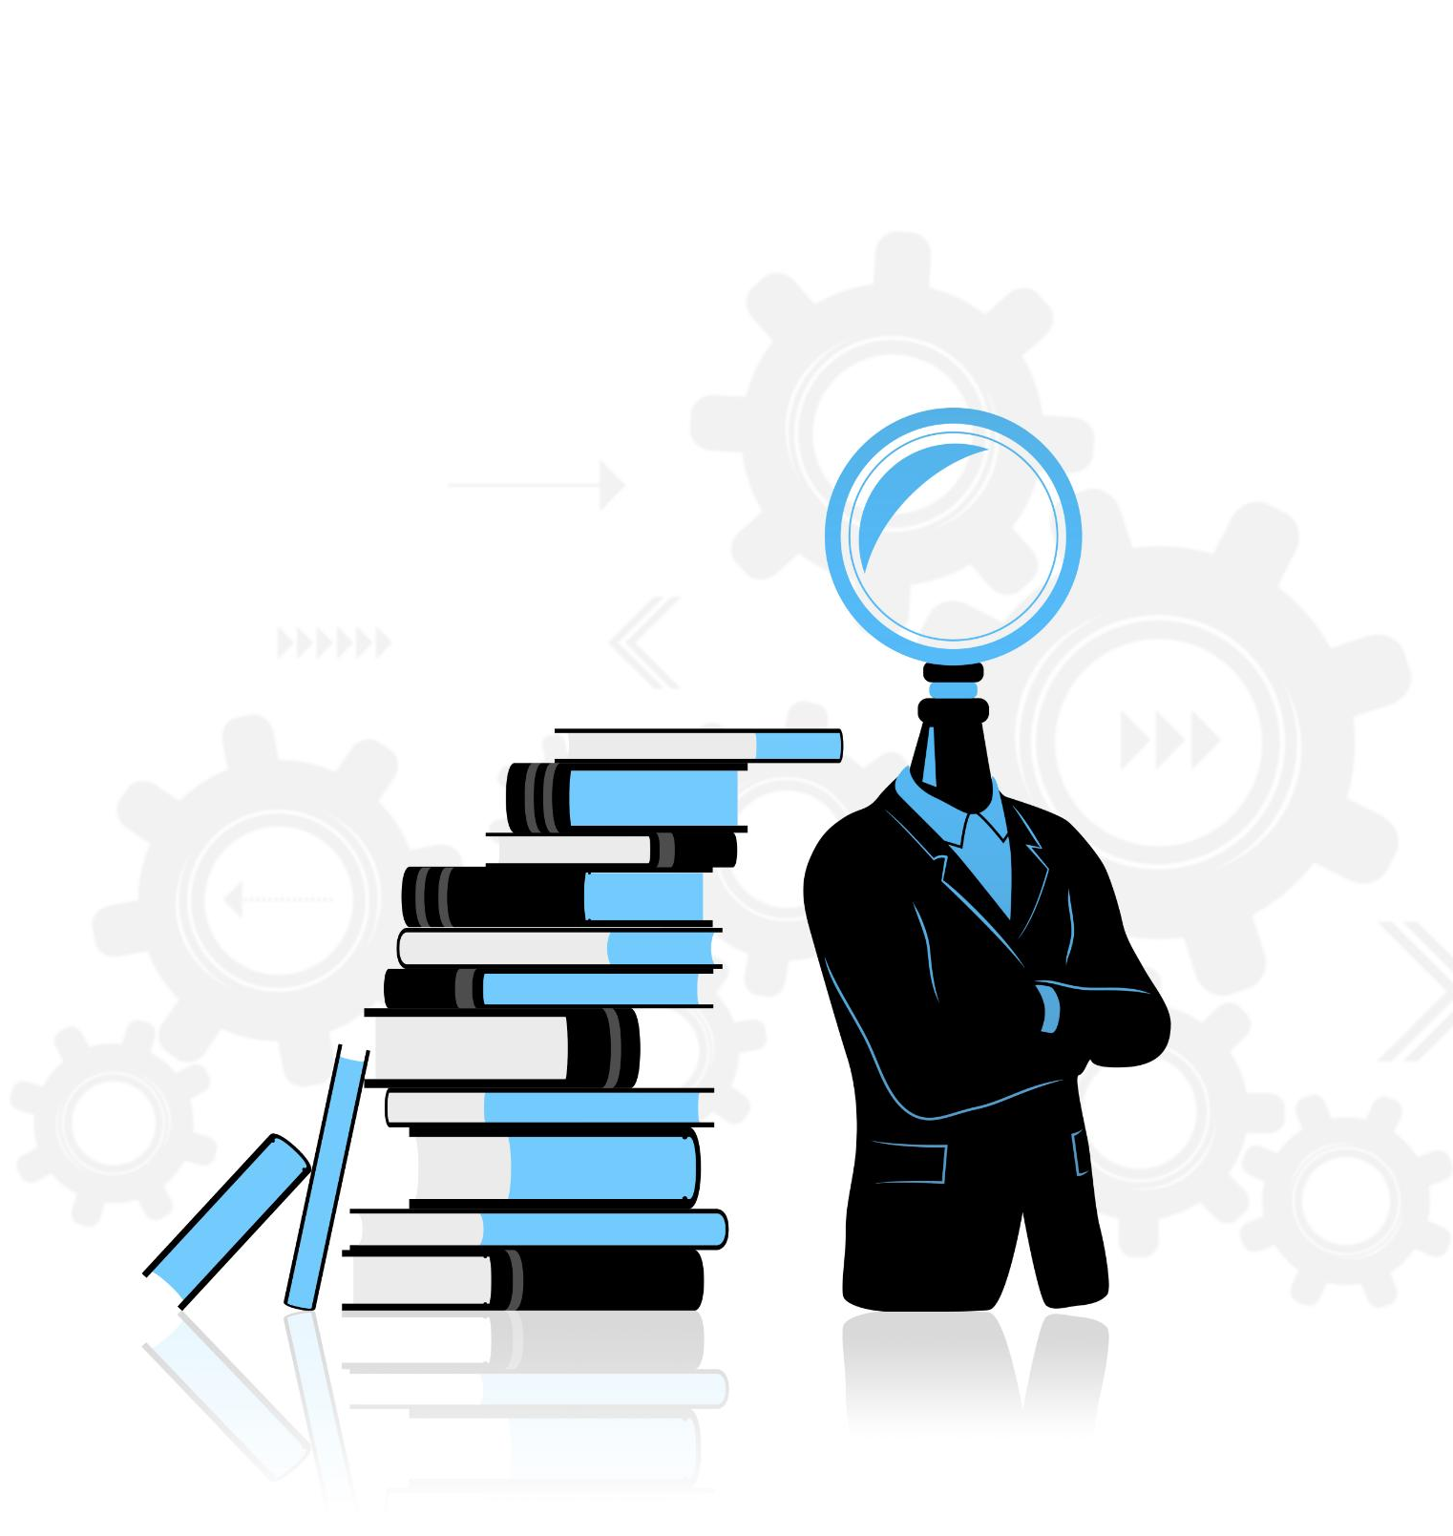
Key References
Research Foundation
Key academic papers like Lewis et al. 2020 establish theoretical foundations for retrieval-augmented generation systems.
Paper link
Technical Documentation
Documentation from LangChain, Qdrant, and Postgres provides practical guidance on system architecture and implementation.
Open Source Code
GitHub repositories like CrewAI, Langchain, and Lang Graph offer real-world examples and source code for building retrieval-augmented generation applications.
Notes:
Lewis et al., Retrieval-Augmented Generation, 2020; LangChain Documentation; Qdrant Documentation; Postgres Official Docs; CrewAI GitHub. These sources provide foundational knowledge and practical guidance for implementing RAG systems, covering theoretical concepts, architectural patterns, and library usage.

